Slide 1
Lecture 7:
Themes in Indian Environmentalism - IV
Course: Environment and Politics in India

Slide 2
ENVIRONMENT
AND
DEVELOPMENT
What is the relationship between ‘DEVELOPMENT’ and the environment?
How do people relate to ‘development’ projects?

Slide 3
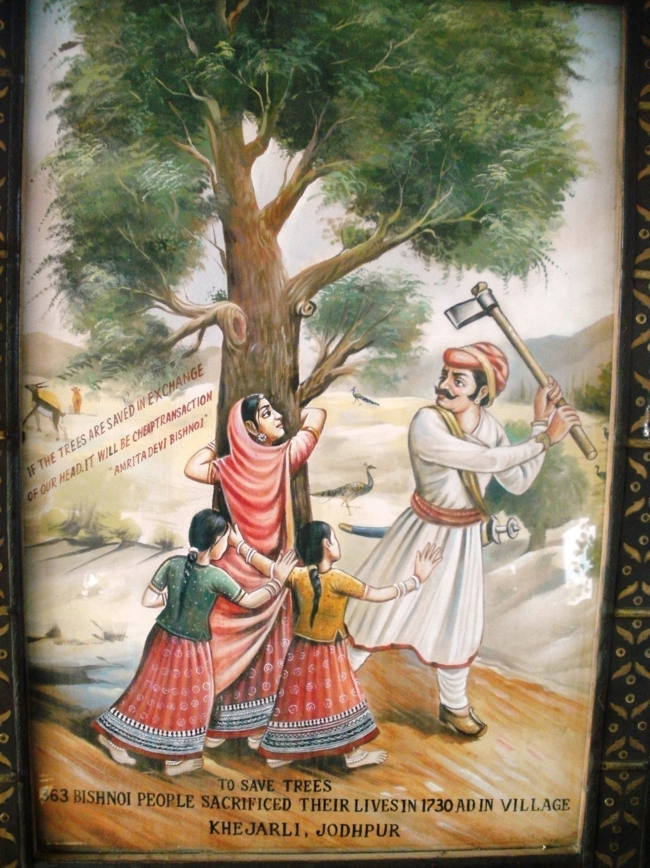

Slide 4
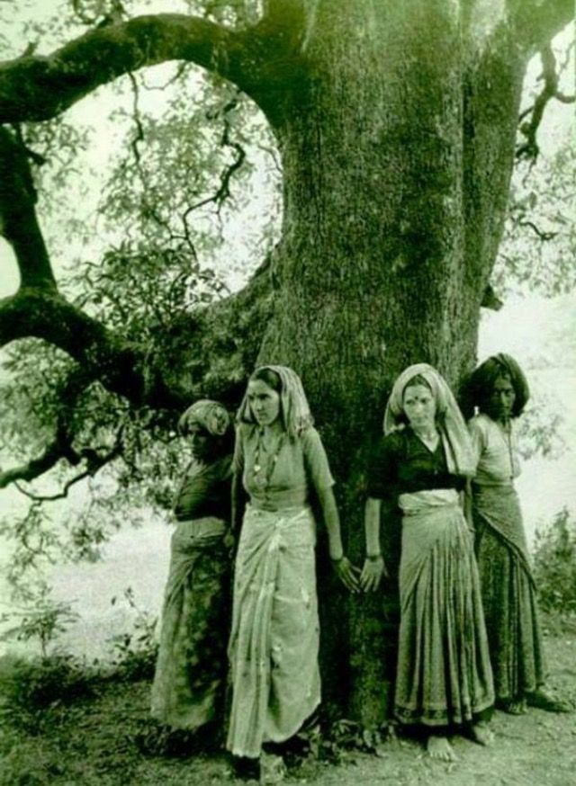

Slide 5
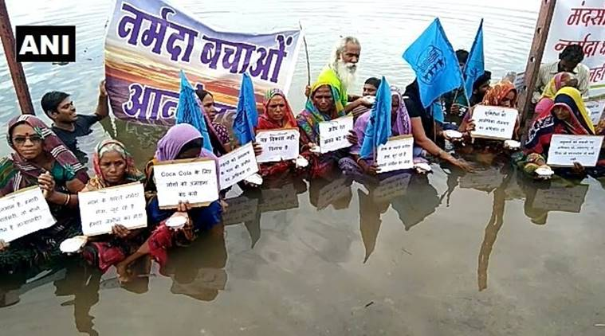

Slide 6
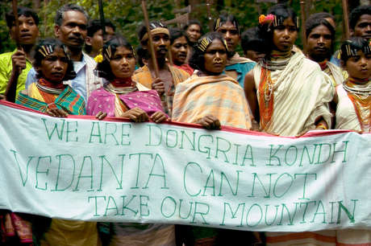

Slide 7
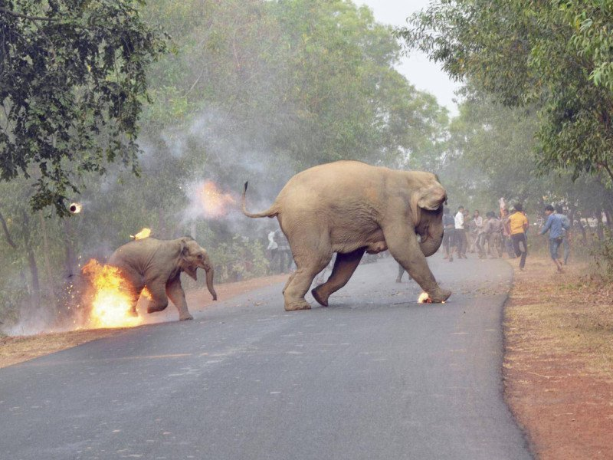

Slide 8
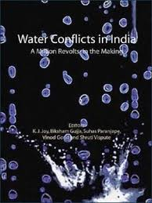
63 Case Studies from India

Slide 9
Water
Various elements of water conflicts/alienation from water resources:
Contending water uses: Drinking/agriculture/industry, wetlands/agriculture. Lack of access to water caused by competitive users. Excess extraction by industry
Equity, access, allocation: Conflicts between same use, different users. Caste/Class/Gender in water use patterns
Conflicts around water quality: Lack of access to clean water downstream of major industries/sewage treatment plants
Sand mining: Indiscriminate sand excavation from riverbeds
Micro-level disputes: Within a village/community/tank/tubewell
Dams and displacement: Hugely documented
Transboundary water conflict: Tamil Nadu/Kerala, Tamil Nadu/Karnataka, Delhi/Haryana
Privatisation

Slide 10
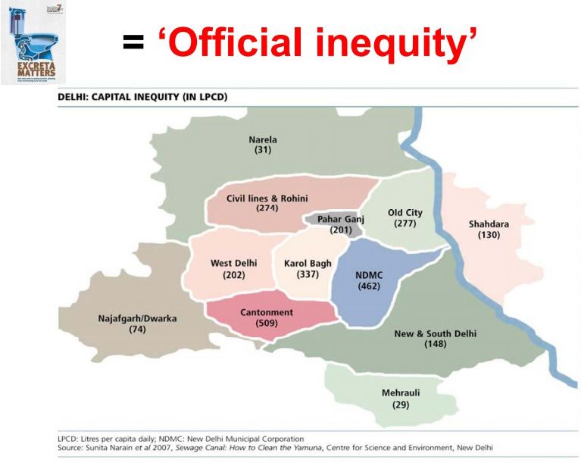

Slide 11
Water
Water privatisation: Involvement of private actors in infrastructure/distribution/pricing. Commodification of water.
FROM ‘scarce’ and ‘sacred’ TO economic product (‘tradable’, ‘profitable’, ‘owned’, ‘marketed’, ‘sold’).
EXAMPLES: Urban and Environmental Infrastructure Facility Project, Karnataka Urban Development and Coastal Environment Management Project (ADB funding, with strings attached), Madhya Pradesh Integrated Water Resources Management Strategy
  Orissa Lift Irrigation Corporation. World Bank involvement. Creation Of Pani Panchayats -> 10 times increase in price
  Sectors involved: BOTH urban and rural. BOTH distribution and sanitation/sewage treatment.
  Likely to impact POOR: Slum dwellers (10-50% of city population), landless.
  Radius Water Ltd. Case: 24 km stretch sold. Restrictions on water use, tubewells, handpumps, fishing, drinking, bathing...

Slide 12


Slide 13
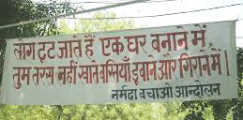
Dams
Issues
Displacement
Loss of livelihoods
Loss of forestland/farmland
Loss of biodiversity
Siltation

Slide 14
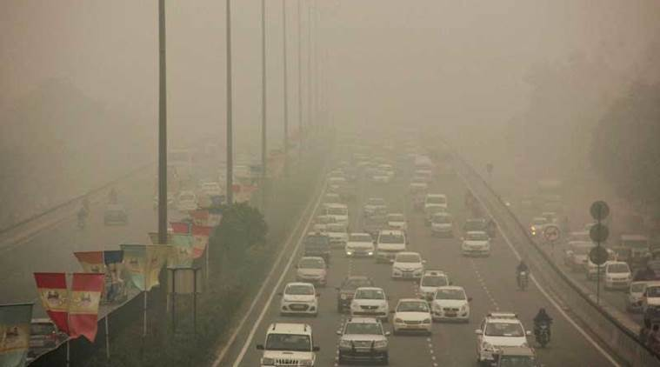
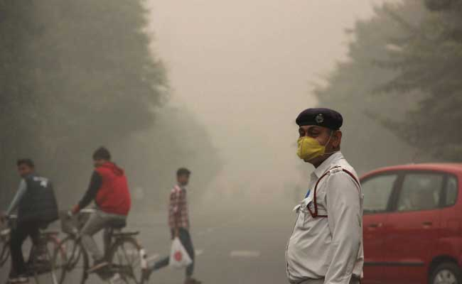
Urban pollution
Smog in North India:
Vehicles
  Traffic composition
  Lack of public transport
  Insufficient road space
Fog in Winter
Agricultural waste burning in Punjab/Haryana
Crackers
Delhi: Most polluted city in India, 4th most polluted in the world.

Slide 15
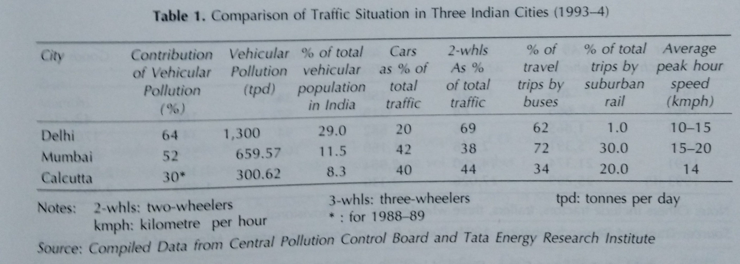
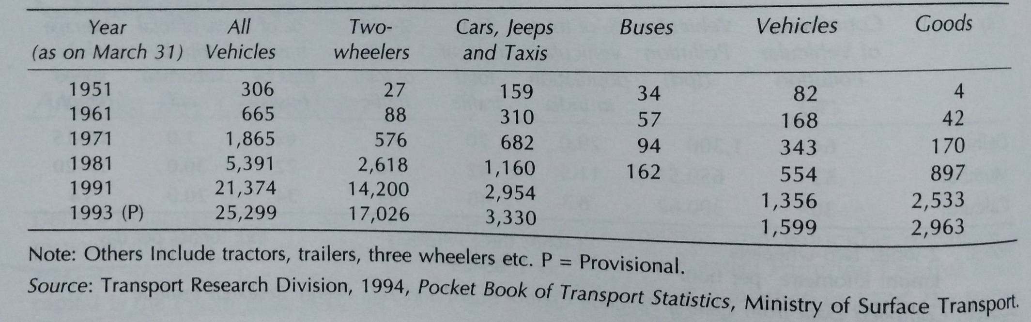

Slide 16
Urban/Industrial pollution
Bhopal gas disaster and its lessons:
Dangers to DEMOCRACY? Skewed decision-making processes. WHO decides WHERE a plant comes up, HOW it is run? NIMBY campaign.
Critiques of ‘development’. Need for an ‘ethical’, ‘green’ economy?
Environmental governance:
  Ecological viability and sustainability
  Social equity
  Democracy and public accountability
  NEED for INSTITUTIONS, STRUCTURES and efficient REGULATORY frameworks.

Slide 17
Different Aspects of Resource Alienation
Common Property Resources (CPRs)
Community assets. Institutional arrangements to manage/use natural resources
  Community Grazing lands
  Village Forests
  Common water resources
KEY cushion/survival, RISK-SHARING mechanism during stress (famines/crop failure)
In dry ecosystems, KEY part of routine coping mechanisms
MEANS to provide for food/fodder/water. 80-100% of poor households depend on CPRs for survival
CPRs are steadily DECLINING

Slide 18
Different Aspects of Resource Alienation
Rural transformation and its role in reducing CPRs:
Manmade factors > Biophysical factors
Increased technological and institutional intervention by the State (between 1950-1980)
  Conversion of CPRs into private lands
  Distance to market centres has reduced substantially
  Irrigation facilities/mechanization/tractorization has increased
  Land prices have increased significantly (3 fold)
  Facilities for public relief, development aid
Physical and market integration of dry areas
Increased population pressure. Population density has doubled.

Slide 19

Different Aspects of Resource Alienation
Rural transformation and its role in reducing CPRs:
Changes in people’s attitude to CPRs
  Increased differentiation of the rural community. Fewer GROUP activities. Less rural cooperation.
  Undermining of traditional water management/fodder and fuel gathering mechanisms.
  Weakening mandate of the community, initiatives/decisions now managed by the State. Legal, administrative and fiscal measures of the State
Changes in farming systems and resource use patterns. DE-EMPHASIZING the role of biomass.

Slide 20
Different Aspects of Resource Alienation
RESULT?
Dependence on CPRs reduced to one-fourth. Dependence on public relief INCREASED manifold.
1950s: 76-84% of households had CPRs as farm inputs
1982-84: 18-22% of households had CPRs as farm inputs
Socio-economic differentiation (along caste/class/gender):
  Decreasing availability: Growing degradation of resources in quality and quantity (water/soil/forests)
  Increasing inequality: Increasing appropriation by State/privatization
  OVERALL impact: reduced availability for the poor/marginalized. EXAMPLE: Green Revolution and Canals/Tube wells.

Slide 21
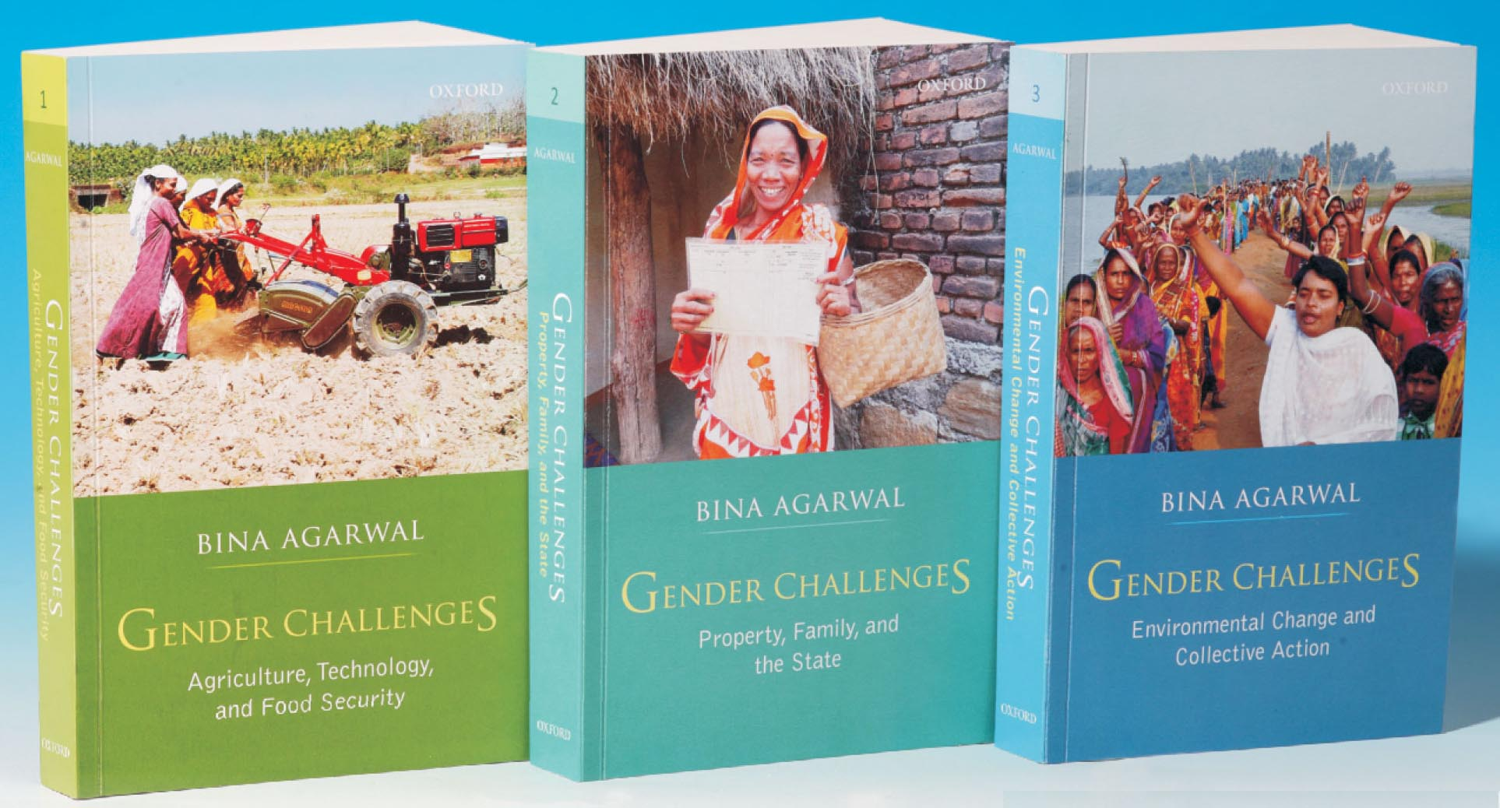
Different Aspects of Resource Alienation
  Gender, Poverty and Environment: Impact on women
  Time: More time required to gather water/food/fuel/fodder
  Income: Erosion of sources of livelihood
  Nutrition: Reduced fuel -> Less/Stale/Uncooked/non-nutritious food
  Health: More directly exposed to polluted water/soils
  Social support networks caused by displacement/modernity
  Knowledge systems: Degradation of material base of old medicinal systems

Slide 22
Environment and Development
  Role of technology on social/ecological systems
  Alienation from natural resources (caused by ‘development’ models)
  Differentiated nature of alienation
  Presence/Absence/Need of regulatory frameworks/institutions
  OVERALL:
  ‘Western’ Models of environmentalism NOT suitable for India. Environment CANNOT be ‘conserved’ FROM the poor.
  Anil Agarwal: GDP versus GNP.
  Role of social/political/economic structures
  Problem of framing the ‘sacred’.

